Slide 1
MARKETINGCOMMUNICATIEPLAN

Slide 3
MARKETINGCOMMUNICATIE
Marketingcommunicatieplan, stappenplan

Slide 4
MARKETINGCOMMUNICATIE
Marketingcommunicatieplan, stappenplan

Slide 5
MARKETINGCOMMUNICATIE
Marketingcommunicatieplan, stappenplan

Slide 6
MARKETINGCOMMUNICATIE
Marketingcommunicatieplan, stappenplan

Slide 7
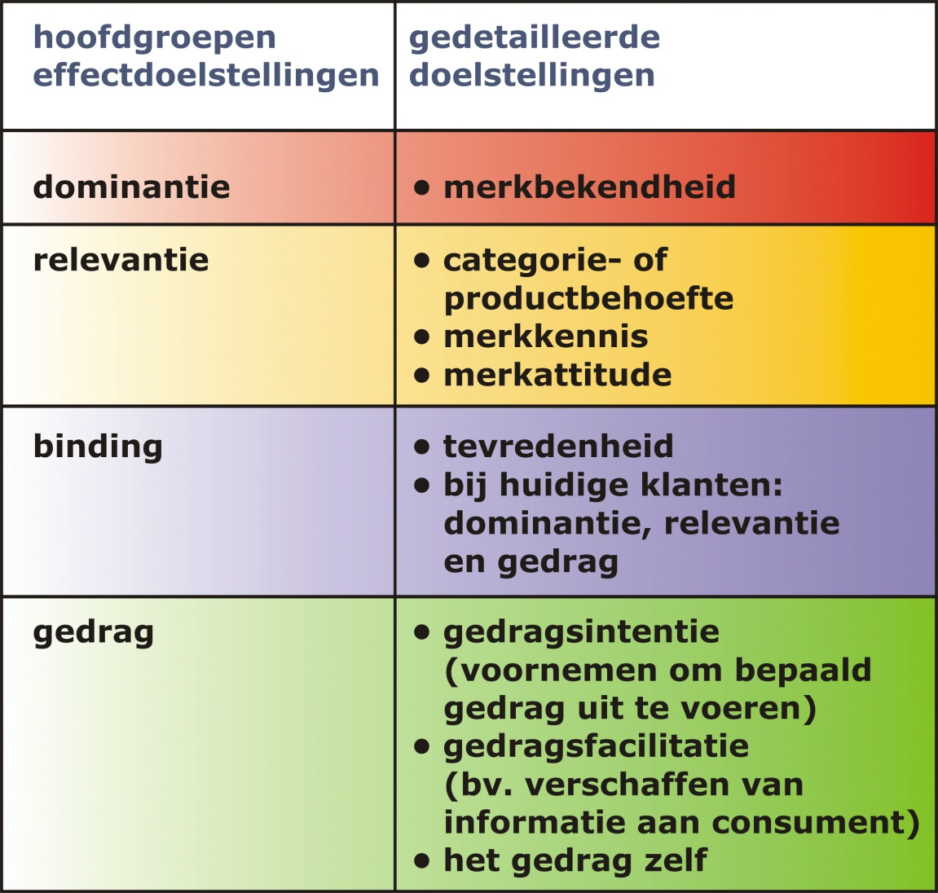
MARKETINGCOMMUNICATIE
Marketingcommunicatieplan, stappenplan

Slide 8
MARKETINGCOMMUNICATIE
Marketingcommunicatieplan, stappenplan

Slide 9
MARKETINGCOMMUNICATIE
Marketingcommunicatieplan, stappenplan

Slide 10
MARKETINGCOMMUNICATIE
Marketingcommunicatieplan, stappenplan

Slide 11
MARKETINGCOMMUNICATIE
Marketingcommunicatieplan, stappenplan

Slide 12
MARKETINGCOMMUNICATIE
Marketingcommunicatieplan, stappenplan

Slide 13
MARKETINGCOMMUNICATIE
Marketingcommunicatieplan, stappenplan

Slide 14
MARKETINGCOMMUNICATIE
Marketingcommunicatieplan, stappenplan

Slide 15
MARKETINGCOMMUNICATIE
Marketingcommunicatieplan, stappenplan

Slide 16
MARKETINGCOMMUNICATIE
Marketingcommunicatieplan, stappenplan

