Slide 1
MARKETINGCOMMUNICATIEPLAN

Slide 3
MARKETINGCOMMUNICATIE
Marketingcommunicatieplan, stappenplan

Slide 4
MARKETINGCOMMUNICATIE
Marketingcommunicatieplan, stappenplan

Slide 5
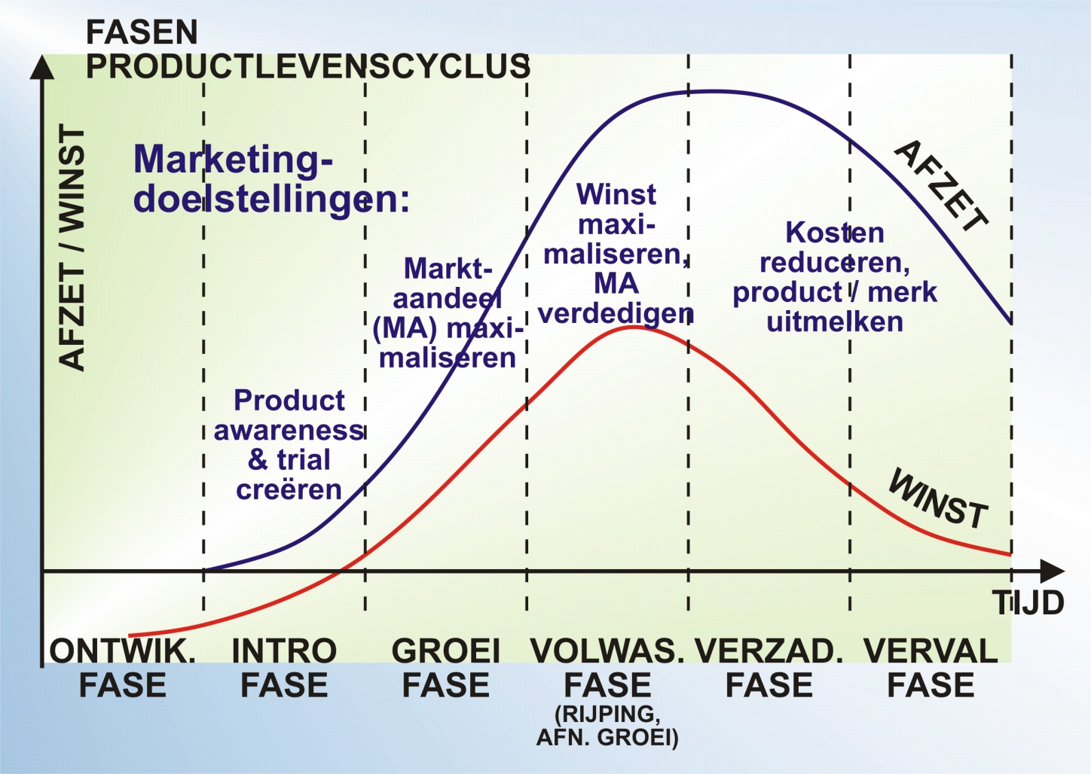
MARKETINGCOMMUNICATIE
Marketingcommunicatieplan, stappenplan

Slide 6
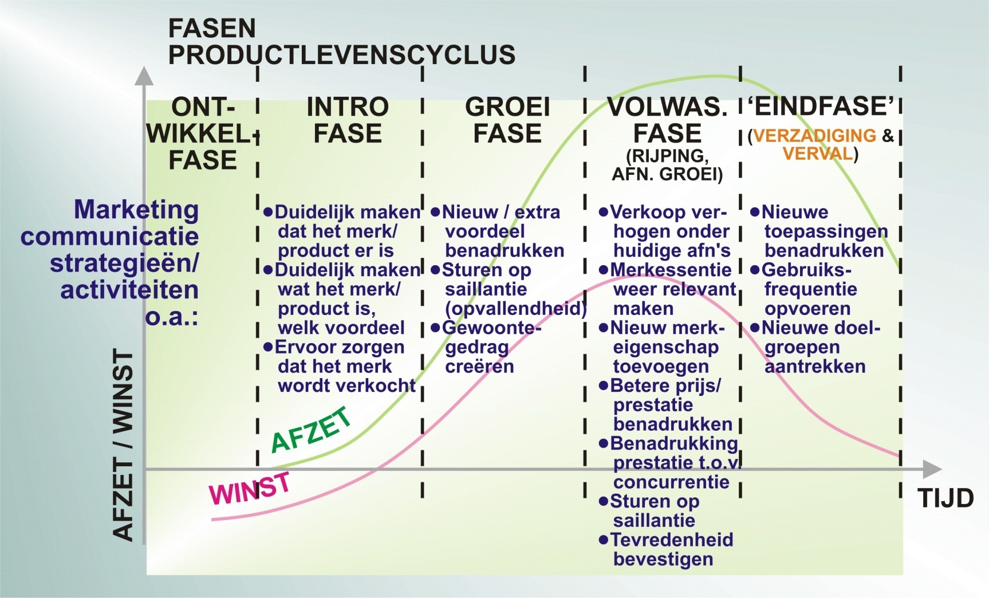
MARKETINGCOMMUNICATIE
Marketingcommunicatieplan, stappenplan

Slide 7
MARKETINGCOMMUNICATIE
Marketingcommunicatieplan, stappenplan

Slide 8
MARKETINGCOMMUNICATIE
Marketingcommunicatieplan, stappenplan

Slide 9
MARKETINGCOMMUNICATIE
Marketingcommunicatieplan, stappenplan

Slide 10
MARKETINGCOMMUNICATIE
Marketingcommunicatieplan, stappenplan

Slide 11
MARKETINGCOMMUNICATIE
Marketingcommunicatieplan, stappenplan

Slide 12
MARKETINGCOMMUNICATIE
Marketingcommunicatieplan, stappenplan

Slide 13
MARKETINGCOMMUNICATIE
Marketingcommunicatieplan, stappenplan

Slide 14
MARKETINGCOMMUNICATIE
Marketingcommunicatieplan, stappenplan

Slide 15
MARKETINGCOMMUNICATIE
Marketingcommunicatieplan, stappenplan

Slide 16
MARKETINGCOMMUNICATIE
Marketingcommunicatieplan, stappenplan

Slide 17
MARKETINGCOMMUNICATIE
Marketingcommunicatieplan, stappenplan

Slide 18
MARKETINGCOMMUNICATIE
Marketingcommunicatieplan, stappenplan

Slide 19
MARKETINGCOMMUNICATIE
Marketingcommunicatieplan, stappenplan

Slide 20
MARKETINGCOMMUNICATIE
Marketingcommunicatieplan, stappenplan

Slide 21
MARKETINGCOMMUNICATIE
Marketingcommunicatieplan, stappenplan

Slide 22
MARKETINGCOMMUNICATIE
Marketingcommunicatieplan, stappenplan

Slide 23
MARKETINGCOMMUNICATIE
Marketingcommunicatieplan, stappenplan

Slide 24
MARKETINGCOMMUNICATIE
Marketingcommunicatieplan, stappenplan

Slide 25
MARKETINGCOMMUNICATIE
Marketingcommunicatieplan, stappenplan

Slide 26
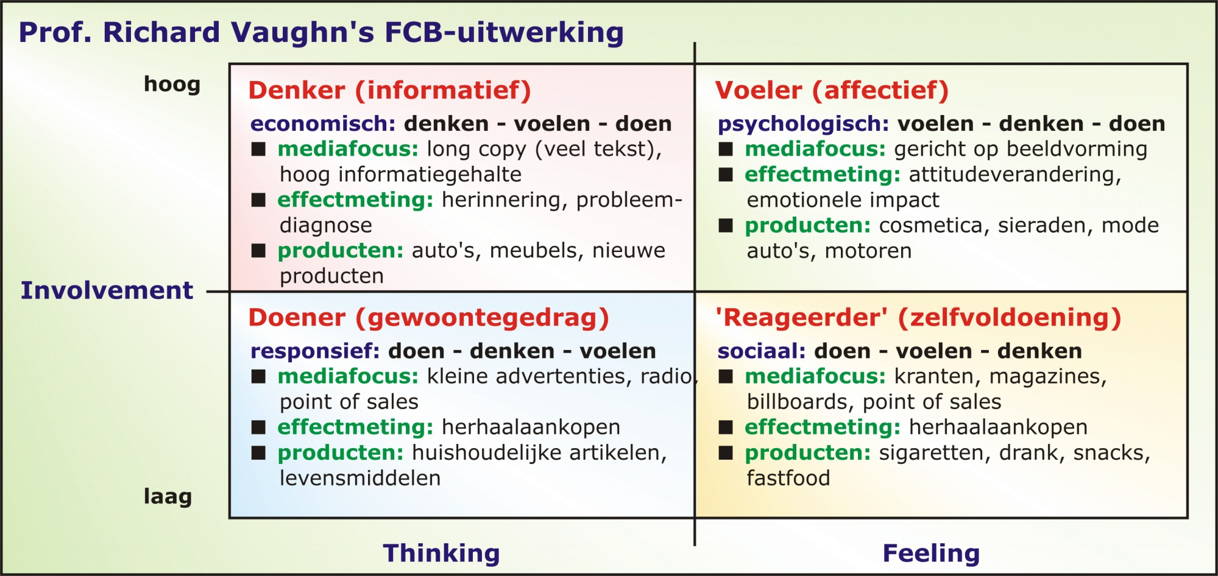
MARKETINGCOMMUNICATIE
Marketingcommunicatieplan, stappenplan

Slide 27
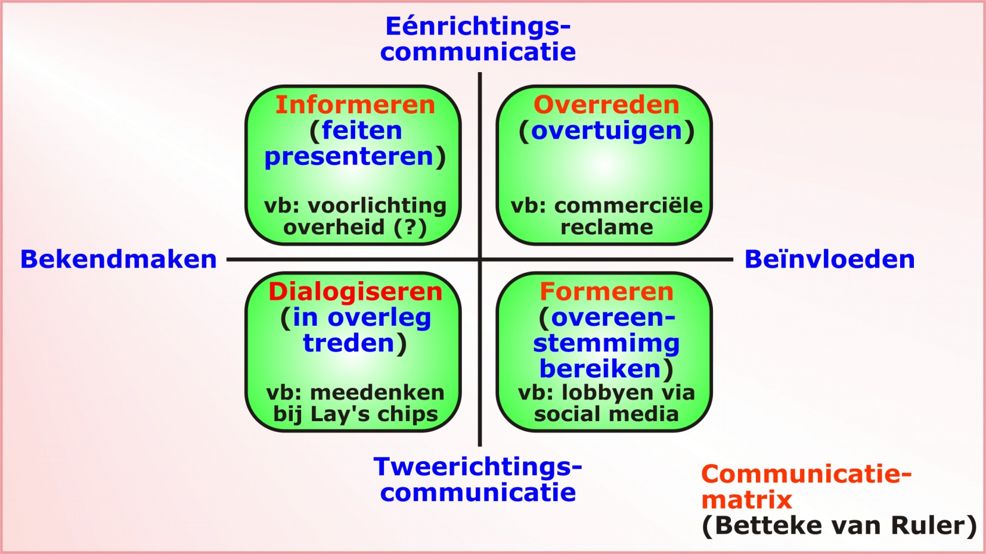
MARKETINGCOMMUNICATIE
Marketingcommunicatieplan, stappenplan

Slide 28
MARKETINGCOMMUNICATIE
Marketingcommunicatieplan, stappenplan

