Slide 1
MARKETINGCOMMUNICATIEPLAN

Slide 3
MARKETINGCOMMUNICATIE
Marketingcommunicatieplan, stappenplan

Slide 4
MARKETINGCOMMUNICATIE
Marketingcommunicatieplan, stappenplan

Slide 5
MARKETINGCOMMUNICATIE
Marketingcommunicatieplan, stappenplan

Slide 6
MARKETINGCOMMUNICATIE
Marketingcommunicatieplan, stappenplan

Slide 7
MARKETINGCOMMUNICATIE
Marketingcommunicatieplan, stappenplan

Slide 8
MARKETINGCOMMUNICATIE
Marketingcommunicatieplan, stappenplan

Slide 9
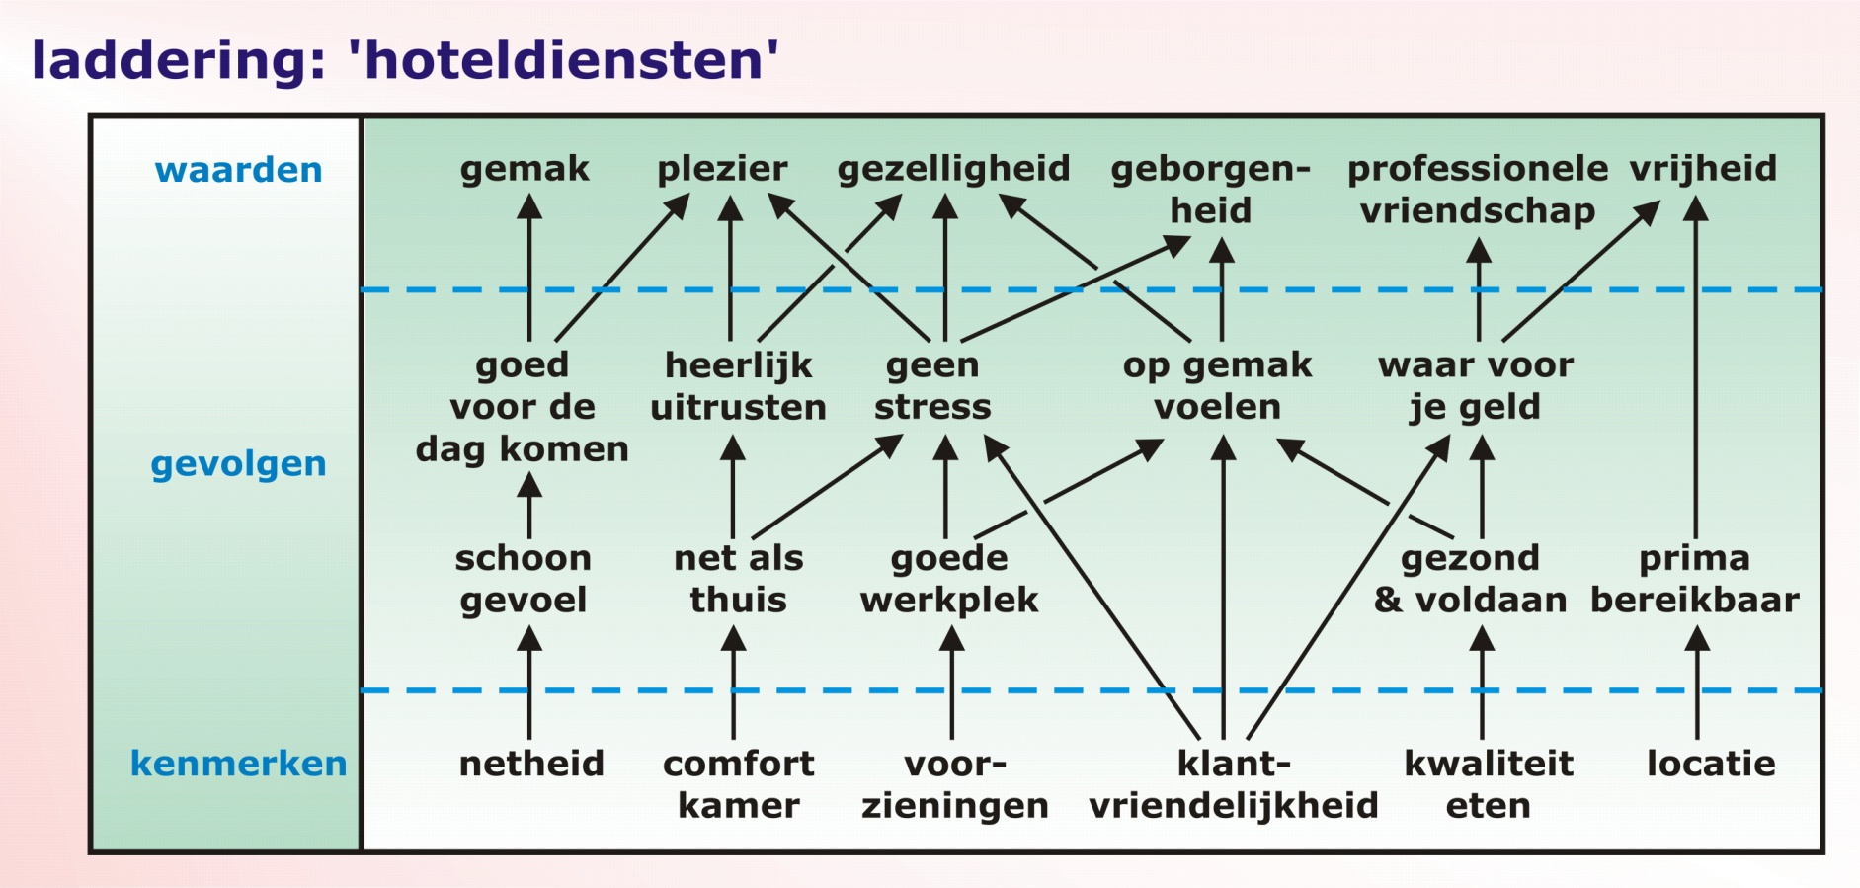
MARKETINGCOMMUNICATIE
Marketingcommunicatieplan, stappenplan

Slide 10
MARKETINGCOMMUNICATIE
Marketingcommunicatieplan, stappenplan

Slide 11
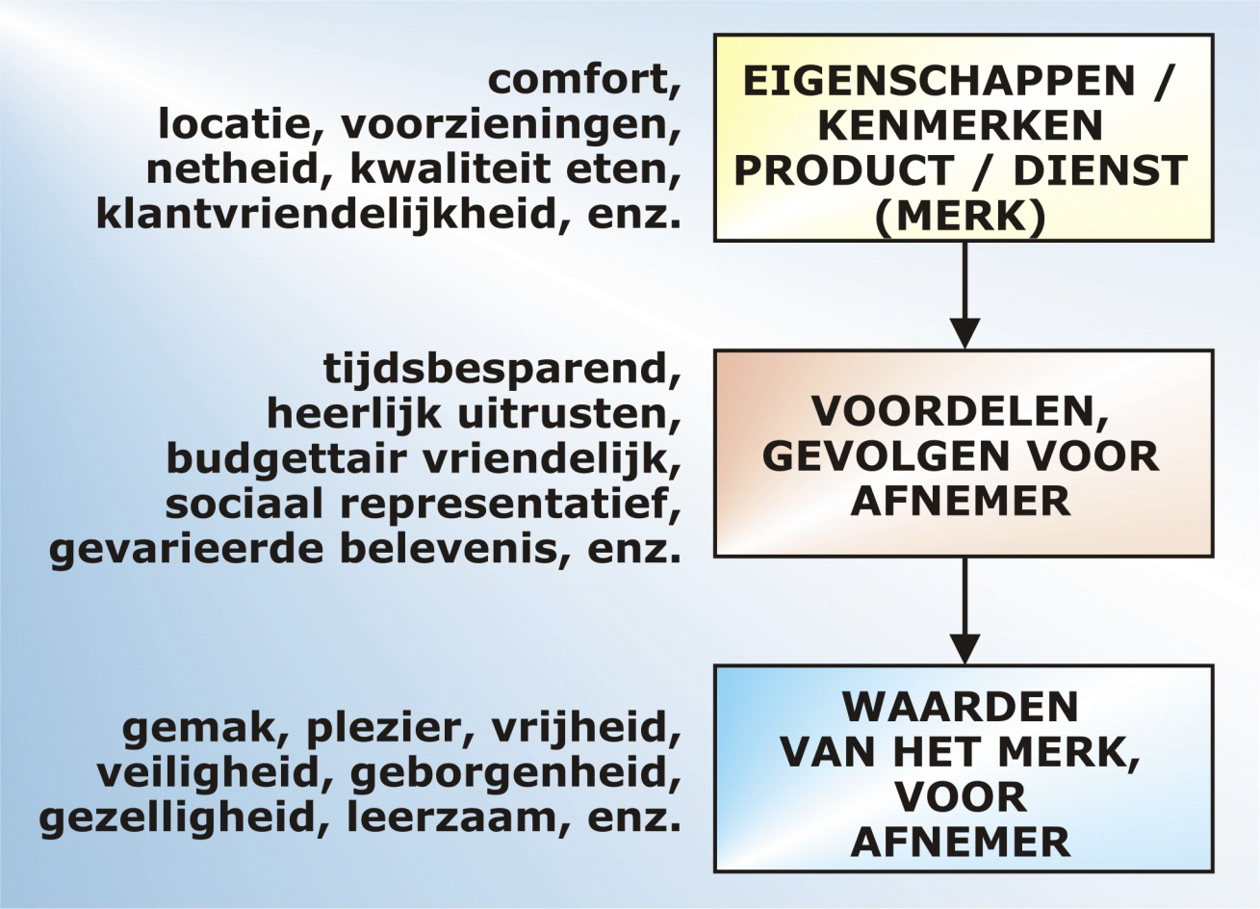
MARKETINGCOMMUNICATIE
Marketingcommunicatieplan, stappenplan

Slide 12
MARKETINGCOMMUNICATIE
Marketingcommunicatieplan, stappenplan

Slide 13
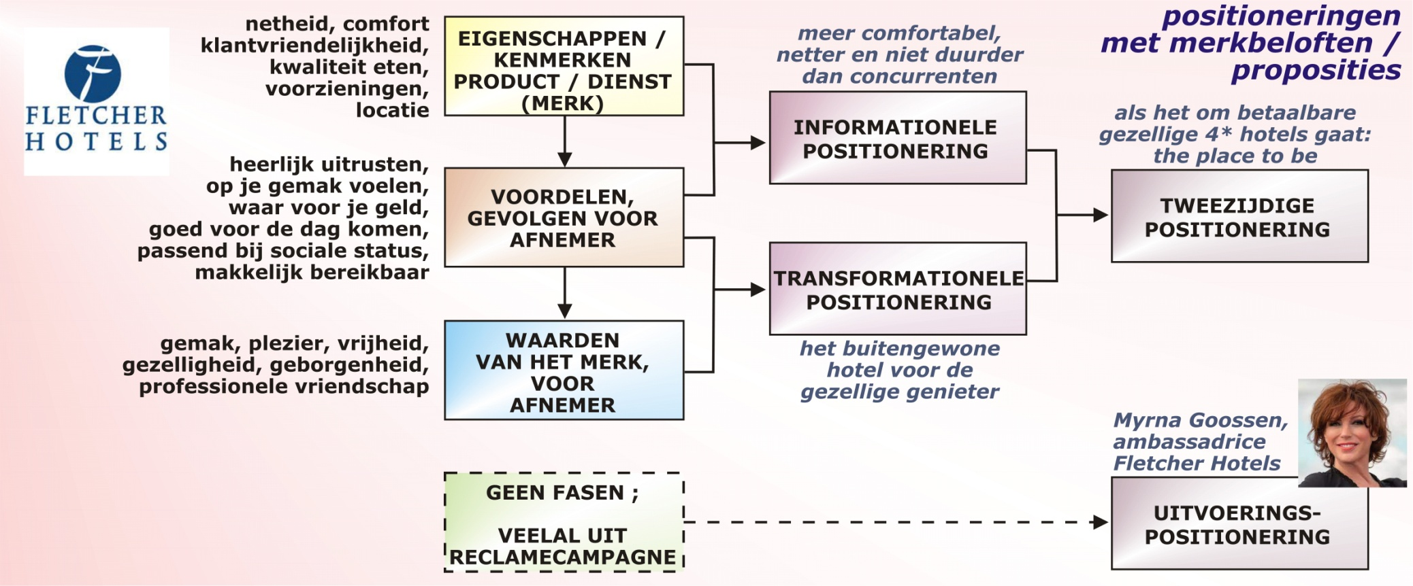
MARKETINGCOMMUNICATIE
Marketingcommunicatieplan, stappenplan

Slide 14
MARKETINGCOMMUNICATIE
Marketingcommunicatieplan, stappenplan

Slide 15
MARKETINGCOMMUNICATIE
Marketingcommunicatieplan, stappenplan

Slide 16
MARKETINGCOMMUNICATIE
Marketingcommunicatieplan, stappenplan

Slide 17
MARKETINGCOMMUNICATIE
Marketingcommunicatieplan, stappenplan

Slide 18
MARKETINGCOMMUNICATIE
Marketingcommunicatieplan, stappenplan

