Slide 1
MARKETINGCOMMUNICATIEPLAN

Slide 3
MARKETINGCOMMUNICATIE
Marketingcommunicatieplan, stappenplan

Slide 4
MARKETINGCOMMUNICATIE
Marketingcommunicatieplan, stappenplan

Slide 5
MARKETINGCOMMUNICATIE
Marketingcommunicatieplan, stappenplan

Slide 6
MARKETINGCOMMUNICATIE
Marketingcommunicatieplan, stappenplan

Slide 7
MARKETINGCOMMUNICATIE
Marketingcommunicatieplan, stappenplan

Slide 8
MARKETINGCOMMUNICATIE
Marketingcommunicatieplan, stappenplan

Slide 9
MARKETINGCOMMUNICATIE
Marketingcommunicatieplan, stappenplan

Slide 10
MARKETINGCOMMUNICATIE
Marketingcommunicatieplan, stappenplan

Slide 11
MARKETINGCOMMUNICATIE
Marketingcommunicatieplan, stappenplan

Slide 12
MARKETINGCOMMUNICATIE
Marketingcommunicatieplan, stappenplan

Slide 13
MARKETINGCOMMUNICATIE
Marketingcommunicatieplan, stappenplan

Slide 14
MARKETINGCOMMUNICATIE
Marketingcommunicatieplan, stappenplan

Slide 15
MARKETINGCOMMUNICATIE
Marketingcommunicatieplan, stappenplan

Slide 16
MARKETINGCOMMUNICATIE
Marketingcommunicatieplan, stappenplan

Slide 17
MARKETINGCOMMUNICATIE
Marketingcommunicatieplan, stappenplan

Slide 18
MARKETINGCOMMUNICATIE
Marketingcommunicatieplan, stappenplan

Slide 19
MARKETINGCOMMUNICATIE
Marketingcommunicatieplan, stappenplan

Slide 20
MARKETINGCOMMUNICATIE
Marketingcommunicatieplan, stappenplan

Slide 21
MARKETINGCOMMUNICATIE
Marketingcommunicatieplan, stappenplan

Slide 22
MARKETINGCOMMUNICATIE
Marketingcommunicatieplan, stappenplan

Slide 23
MARKETINGCOMMUNICATIE
Marketingcommunicatieplan, stappenplan

Slide 24
MARKETINGCOMMUNICATIE
Marketingcommunicatieplan, stappenplan

Slide 25
MARKETINGCOMMUNICATIE
Marketingcommunicatieplan, stappenplan

Slide 26
MARKETINGCOMMUNICATIE
Marketingcommunicatieplan, stappenplan

Slide 27
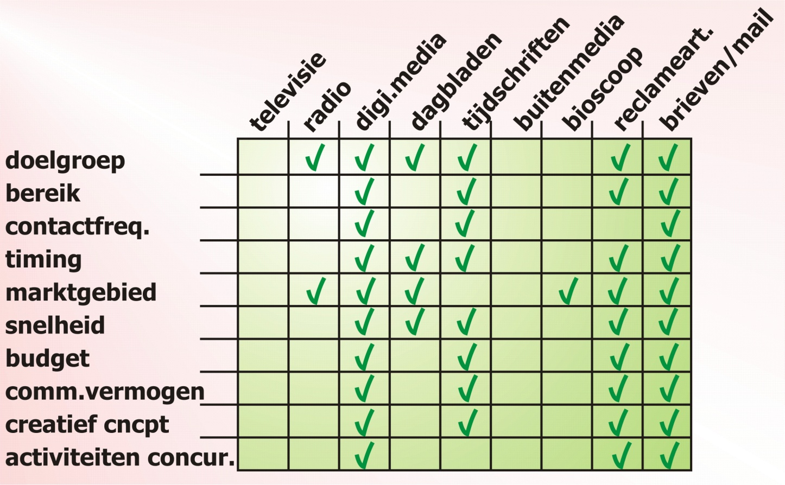
MARKETINGCOMMUNICATIE
Marketingcommunicatieplan, stappenplan

Slide 28
MARKETINGCOMMUNICATIE
Marketingcommunicatieplan, stappenplan

Slide 29
MARKETINGCOMMUNICATIE
Marketingcommunicatieplan, stappenplan

Slide 30
MARKETINGCOMMUNICATIE
Marketingcommunicatieplan, stappenplan

Slide 31
MARKETINGCOMMUNICATIE
Marketingcommunicatieplan, stappenplan

Slide 32
MARKETINGCOMMUNICATIE
Marketingcommunicatieplan, stappenplan

Slide 33
MARKETINGCOMMUNICATIE
Marketingcommunicatieplan, stappenplan

Slide 34
MARKETINGCOMMUNICATIE
Marketingcommunicatieplan, stappenplan

Slide 35
MARKETINGCOMMUNICATIE
Marketingcommunicatieplan, stappenplan

Slide 36
MARKETINGCOMMUNICATIE
Marketingcommunicatieplan, stappenplan

Slide 37
MARKETINGCOMMUNICATIE
Marketingcommunicatieplan, stappenplan

Slide 38
MARKETINGCOMMUNICATIE
Marketingcommunicatieplan, stappenplan

Slide 39
MARKETINGCOMMUNICATIE
Marketingcommunicatieplan, stappenplan

Slide 40
MARKETINGCOMMUNICATIE
Marketingcommunicatieplan, stappenplan

Slide 41
MARKETINGCOMMUNICATIE
Marketingcommunicatieplan, stappenplan

Slide 42
MARKETINGCOMMUNICATIE
Marketingcommunicatieplan, stappenplan

Slide 43
MARKETINGCOMMUNICATIE
Marketingcommunicatieplan, stappenplan

Slide 44
MARKETINGCOMMUNICATIE
Marketingcommunicatieplan, stappenplan

Slide 45
MARKETINGCOMMUNICATIE
Marketingcommunicatieplan, stappenplan

Slide 46
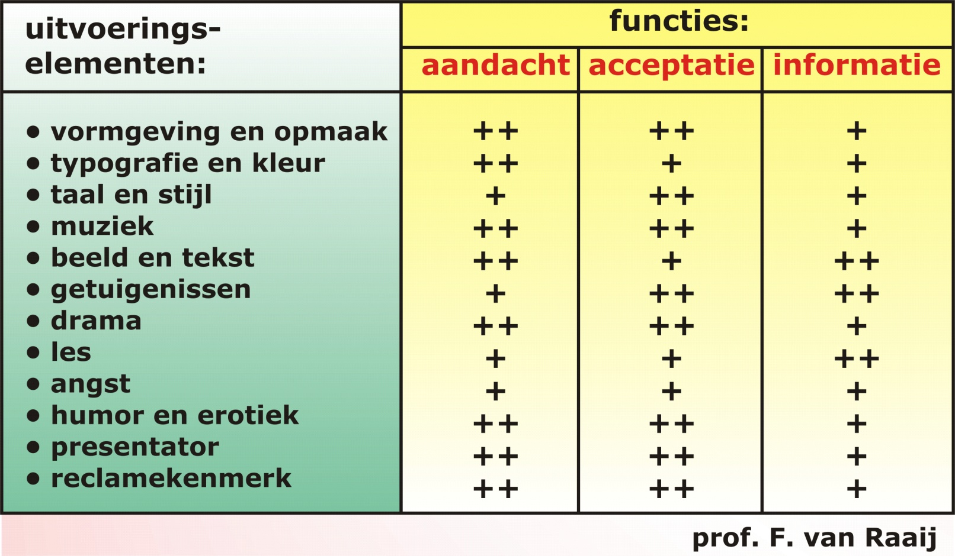
MARKETINGCOMMUNICATIE
Marketingcommunicatieplan, stappenplan

Slide 47
MARKETINGCOMMUNICATIE
Marketingcommunicatieplan, stappenplan

Slide 48
MARKETINGCOMMUNICATIE
Marketingcommunicatieplan, stappenplan

Slide 49
MARKETINGCOMMUNICATIE
Marketingcommunicatieplan, stappenplan

Slide 50
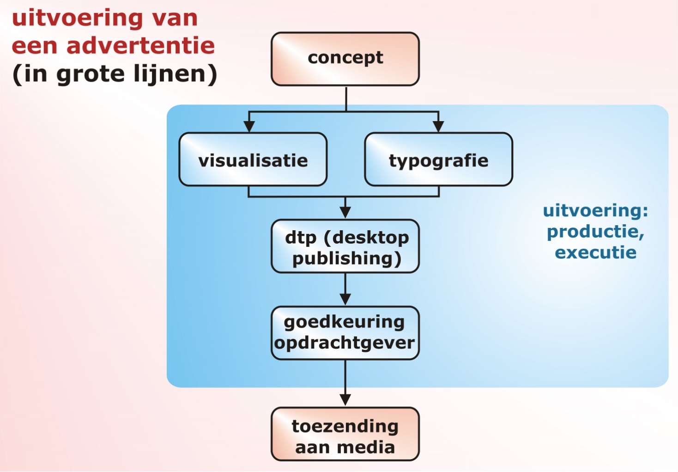
MARKETINGCOMMUNICATIE
Marketingcommunicatieplan, stappenplan

