Slide 1
MARKETINGCOMMUNICATIEPLAN

Slide 3
MARKETINGCOMMUNICATIE
Marketingcommunicatieplan, stappenplan

Slide 4
MARKETINGCOMMUNICATIE
Marketingcommunicatieplan, stappenplan

Slide 5
MARKETINGCOMMUNICATIE
Marketingcommunicatieplan, stappenplan

Slide 6
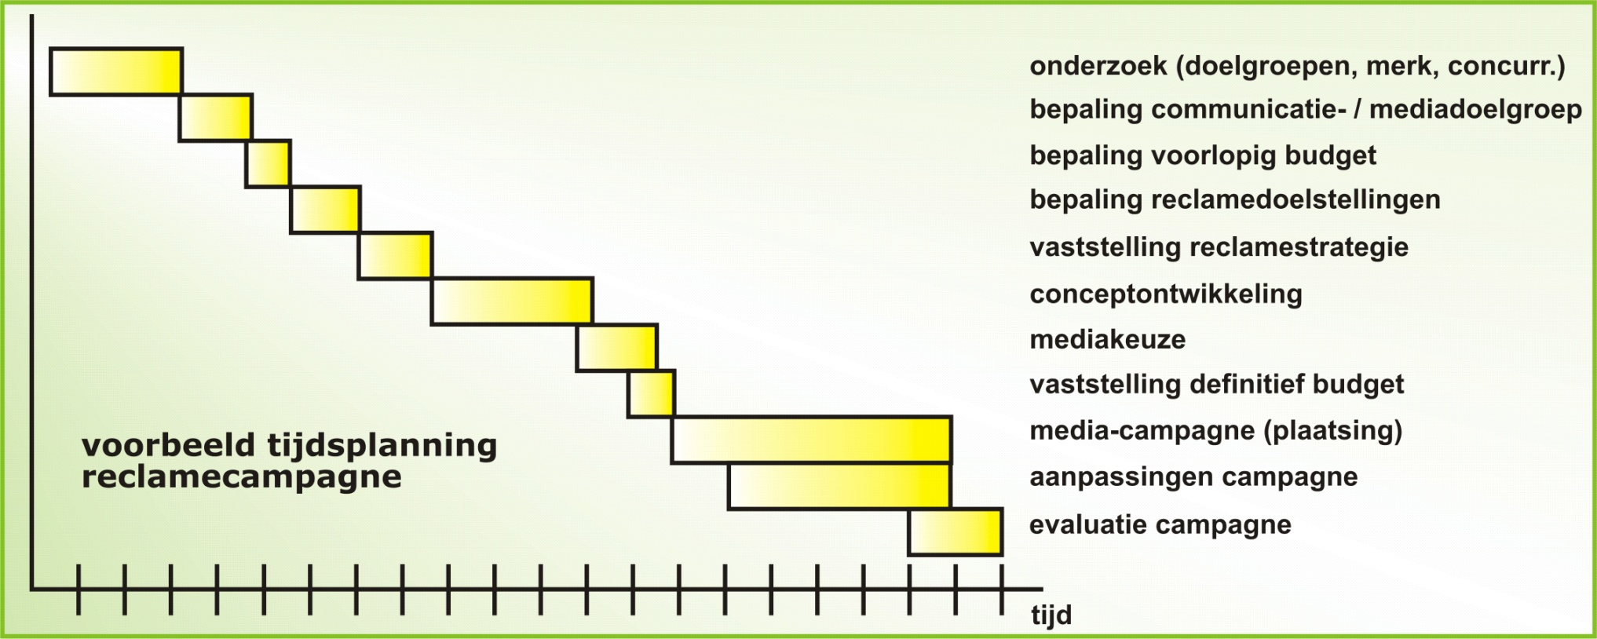
MARKETINGCOMMUNICATIE
Marketingcommunicatieplan, stappenplan

Slide 7
MARKETINGCOMMUNICATIE
Marketingcommunicatieplan, stappenplan

Slide 8
MARKETINGCOMMUNICATIE
Marketingcommunicatieplan, stappenplan

Slide 9
MARKETINGCOMMUNICATIE
Marketingcommunicatieplan, stappenplan

Slide 10
MARKETINGCOMMUNICATIE
Marketingcommunicatieplan, stappenplan

Slide 11
MARKETINGCOMMUNICATIE
Marketingcommunicatieplan, stappenplan

Slide 12
MARKETINGCOMMUNICATIE
Marketingcommunicatieplan, stappenplan

Slide 13
MARKETINGCOMMUNICATIE
Marketingcommunicatieplan, stappenplan

