Slide 1
ONLINE MARKETING / 08

Slide 3
ONLINE MARKETING / 08
Content marketing, storytelling en engaging content

Slide 4
ONLINE MARKETING / 08
Content marketing, storytelling en engaging content

Slide 5
ONLINE MARKETING / 08
Content marketing, storytelling en engaging content

Slide 6
ONLINE MARKETING / 08
Content marketing, storytelling en engaging content

Slide 7
ONLINE MARKETING / 08
Content marketing, storytelling en engaging content

Slide 8
ONLINE MARKETING / 08
Content marketing, storytelling en engaging content

Slide 9
ONLINE MARKETING / 08
Content marketing, storytelling en engaging content

Slide 10
ONLINE MARKETING / 08
Content marketing, storytelling en engaging content

Slide 12
ONLINE MARKETING / 08
Content marketing, storytelling en engaging content

Slide 13
ONLINE MARKETING / 08
Content marketing, storytelling en engaging content

Slide 14
ONLINE MARKETING / 08
Content marketing, storytelling en engaging content

Slide 15
ONLINE MARKETING / 08
Content marketing, storytelling en engaging content

Slide 16
ONLINE MARKETING / 08
Content marketing, storytelling en engaging content

Slide 17
ONLINE MARKETING / 08
Content marketing, storytelling en engaging content

Slide 18
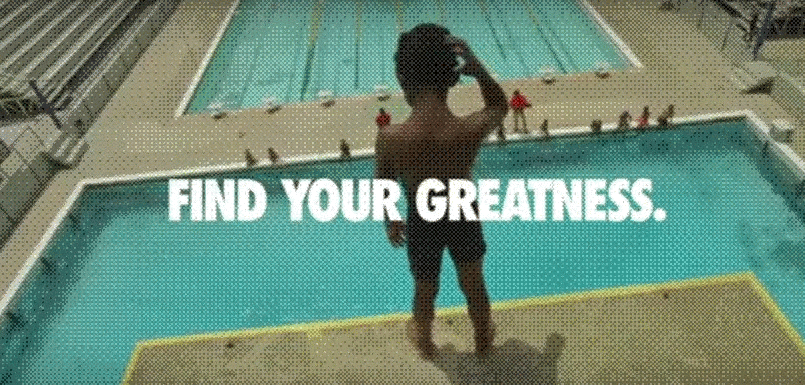
ONLINE MARKETING / 08
Content marketing, storytelling en engaging content

Slide 19
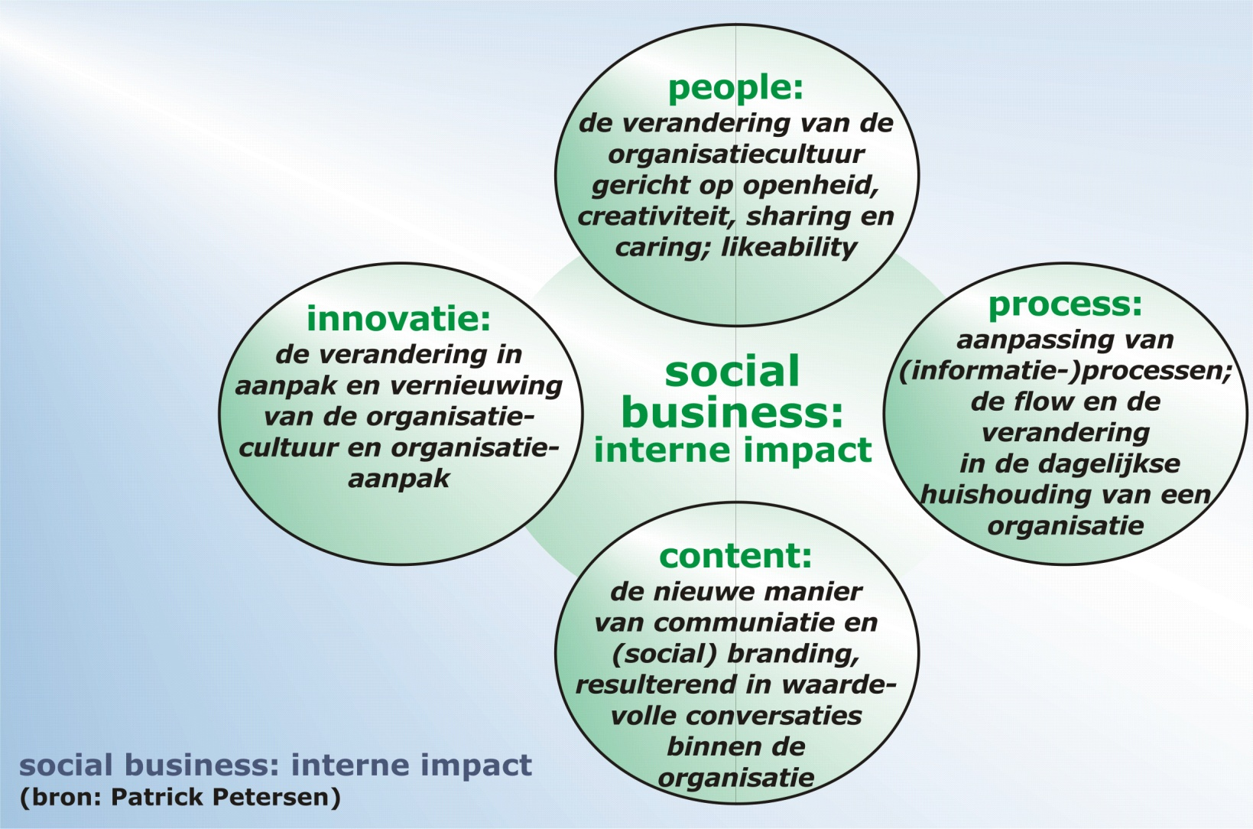
ONLINE MARKETING / 08
Content marketing, storytelling en engaging content

Slide 21
ONLINE MARKETING / 08
Content marketing, storytelling en engaging content

Slide 22
ONLINE MARKETING / 08
Content marketing, storytelling en engaging content

Slide 23
ONLINE MARKETING / 08
Content marketing, storytelling en engaging content

Slide 24
ONLINE MARKETING / 08
Content marketing, storytelling en engaging content

Slide 25
ONLINE MARKETING / 08
Content marketing, storytelling en engaging content

Slide 26
ONLINE MARKETING / 08
Content marketing, storytelling en engaging content

Slide 27
ONLINE MARKETING / 08
Content marketing, storytelling en engaging content

Slide 28
ONLINE MARKETING / 08
Content marketing, storytelling en engaging content

Slide 30
ONLINE MARKETING / 08
Content marketing, storytelling en engaging content

Slide 31
ONLINE MARKETING / 08
Content marketing, storytelling en engaging content

Slide 32
ONLINE MARKETING / 08
Content marketing, storytelling en engaging content

Slide 33
ONLINE MARKETING / 08
Content marketing, storytelling en engaging content

Slide 34
ONLINE MARKETING / 08
Content marketing, storytelling en engaging content

Slide 35
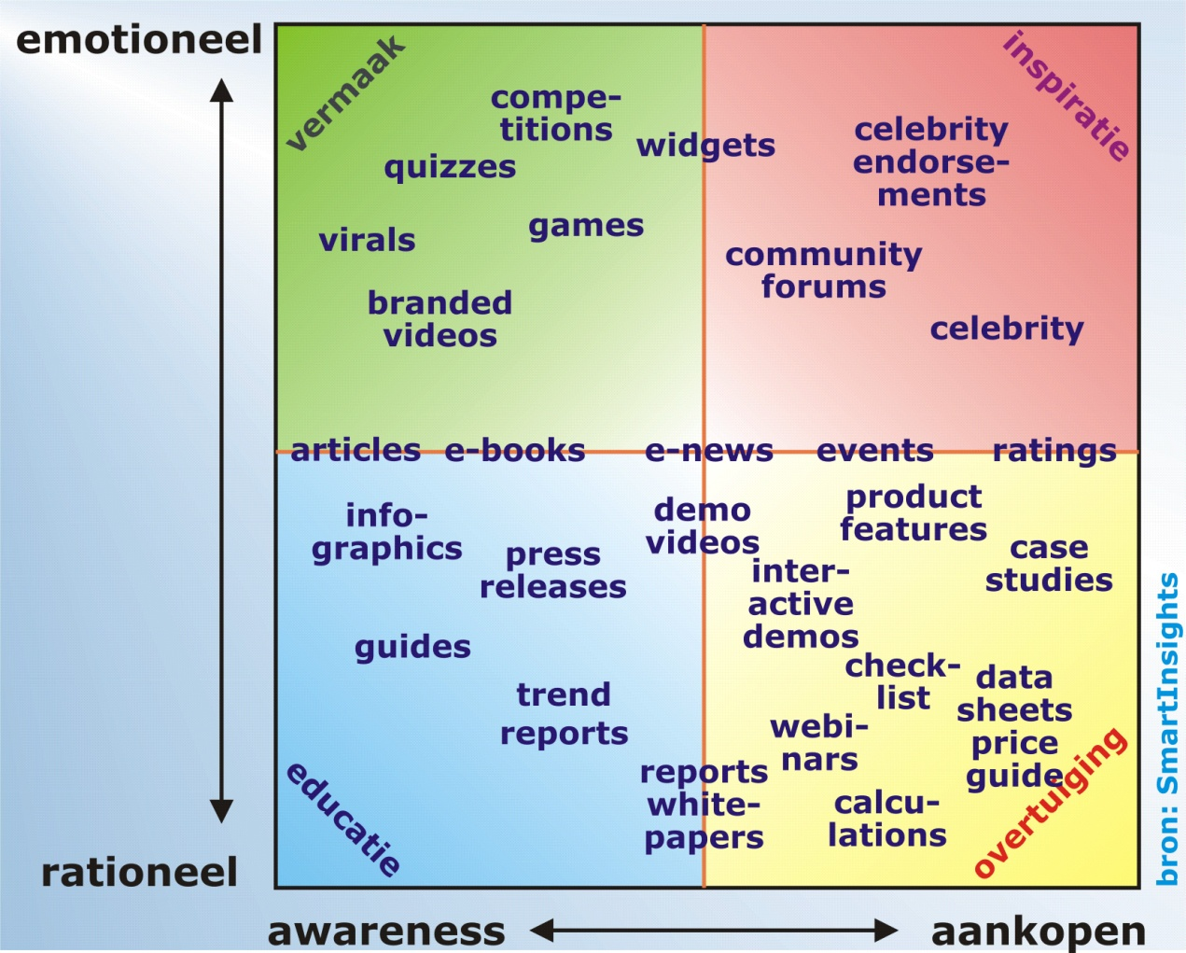
ONLINE MARKETING / 08
Content marketing, storytelling en engaging content

Slide 36
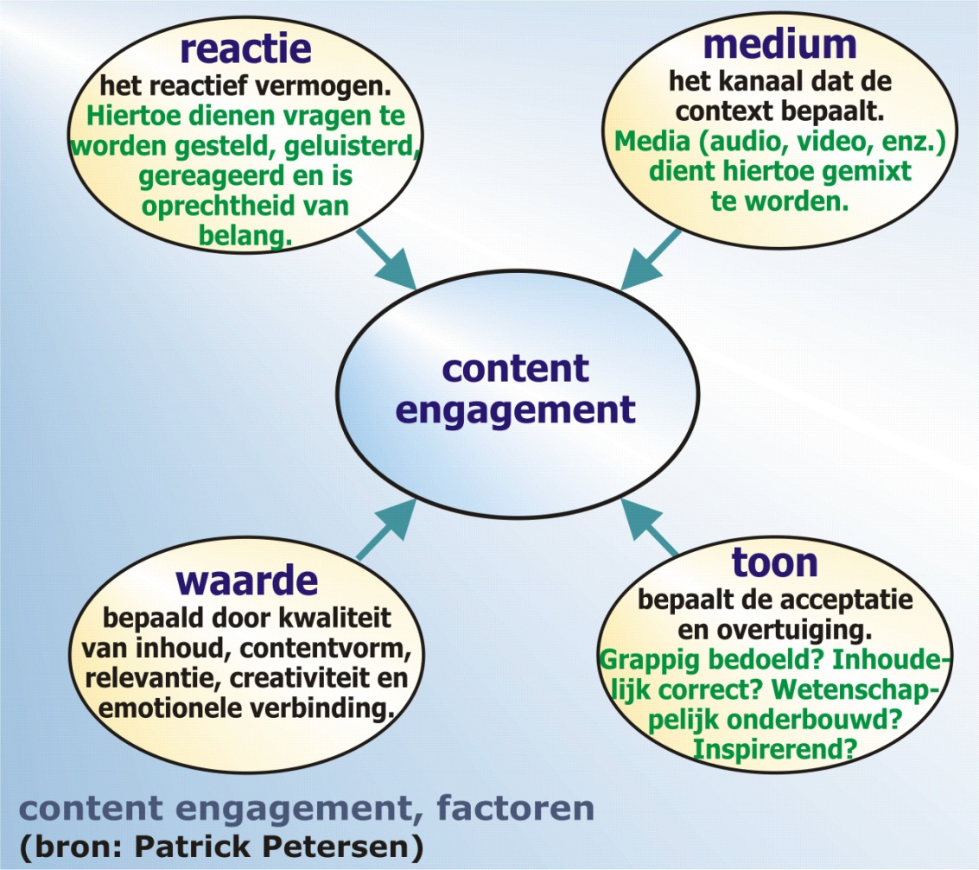
ONLINE MARKETING / 08
Content marketing, storytelling en engaging content

Slide 37
ONLINE MARKETING / 08
Content marketing, storytelling en engaging content

Slide 38
ONLINE MARKETING / 08
Content marketing, storytelling en engaging content

