Slide 1
ONLINE MARKETING / 10

Slide 3
ONLINE MARKETING / 10
Search engine marketing: SEO, SEA en SEP

Slide 4
ONLINE MARKETING / 10
Search engine marketing: SEO, SEA en SEP

Slide 5
ONLINE MARKETING / 10
Search engine marketing: SEO, SEA en SEP

Slide 6
ONLINE MARKETING / 10
Search engine marketing: SEO, SEA en SEP

Slide 7
ONLINE MARKETING / 10
Search engine marketing: SEO, SEA en SEP

Slide 8
ONLINE MARKETING / 10
Search engine marketing: SEO, SEA en SEP

Slide 9
ONLINE MARKETING / 10
Search engine marketing: SEO, SEA en SEP

Slide 10
ONLINE MARKETING / 10
Search engine marketing: SEO, SEA en SEP

Slide 11
ONLINE MARKETING / 10
Search engine marketing: SEO, SEA en SEP

Slide 12
ONLINE MARKETING / 10
Search engine marketing: SEO, SEA en SEP

Slide 13
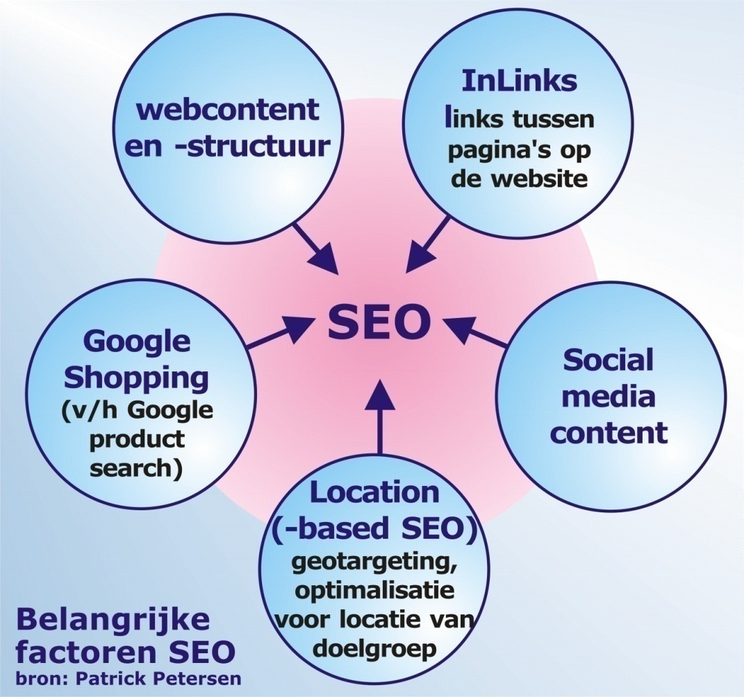
ONLINE MARKETING / 10
Search engine marketing: SEO, SEA en SEP

Slide 14
ONLINE MARKETING / 10
Search engine marketing: SEO, SEA en SEP

Slide 15
ONLINE MARKETING / 10
Search engine marketing: SEO, SEA en SEP

Slide 16
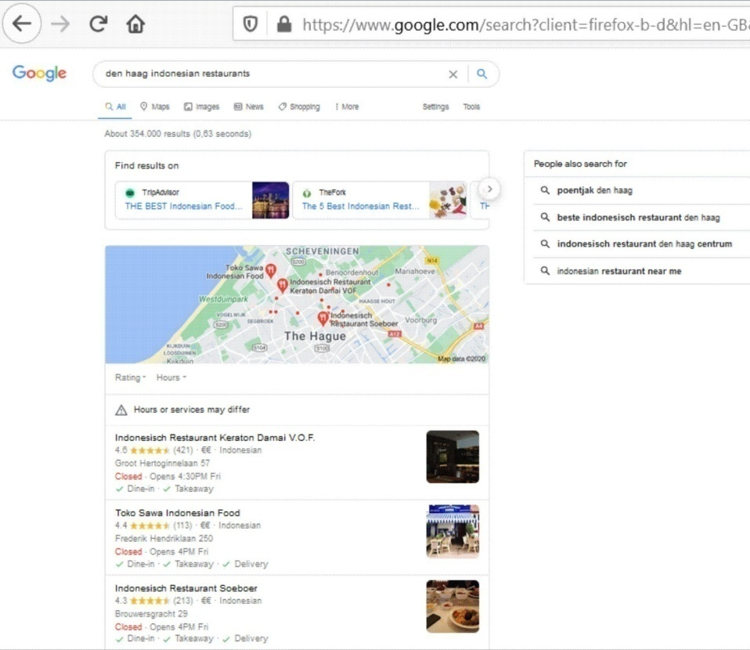
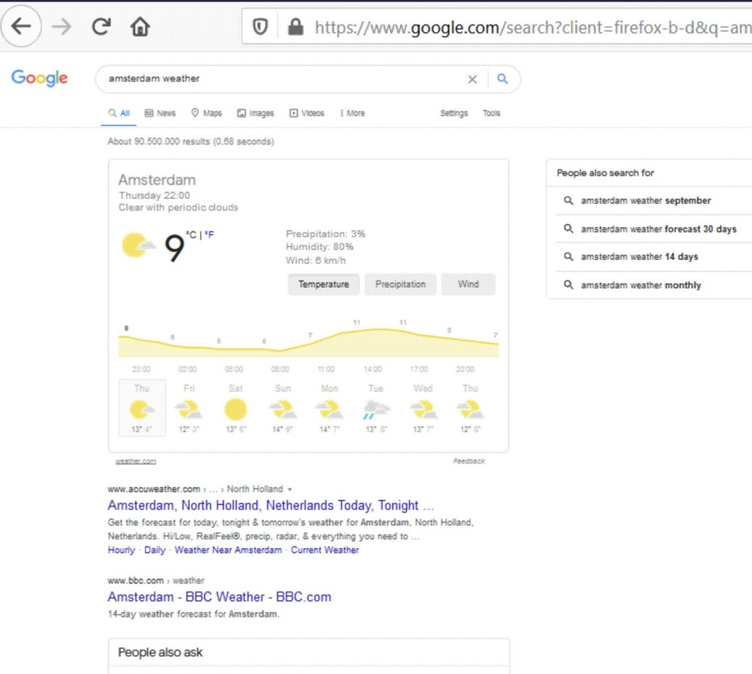
ONLINE MARKETING / 10
Search engine marketing: SEO, SEA en SEP

Slide 17
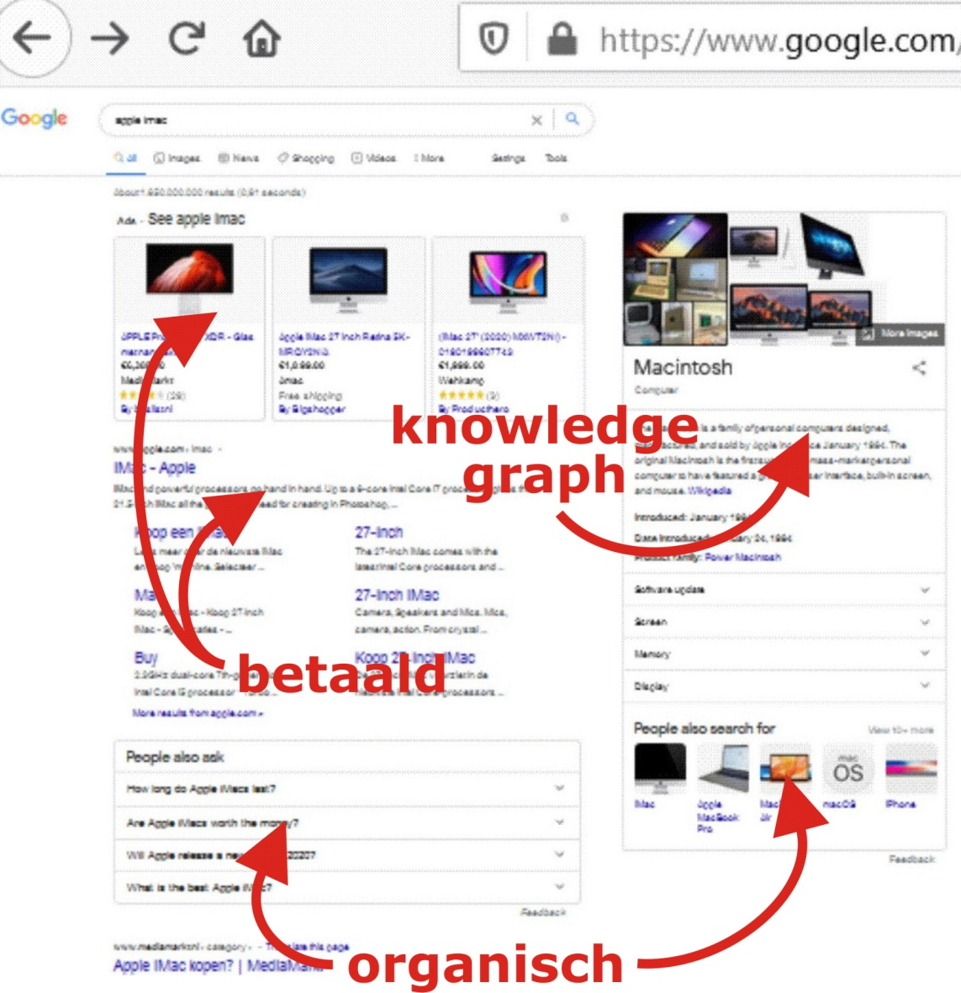
ONLINE MARKETING / 10
Search engine marketing: SEO, SEA en SEP

Slide 18
ONLINE MARKETING / 10
Search engine marketing: SEO, SEA en SEP

Slide 19
ONLINE MARKETING / 10
Search engine marketing: SEO, SEA en SEP

Slide 20
ONLINE MARKETING / 10
Search engine marketing: SEO, SEA en SEP

Slide 21
ONLINE MARKETING / 10
Search engine marketing: SEO, SEA en SEP

Slide 23
ONLINE MARKETING / 10
Search engine marketing: SEO, SEA en SEP

Slide 24
ONLINE MARKETING / 10
Search engine marketing: SEO, SEA en SEP

Slide 25
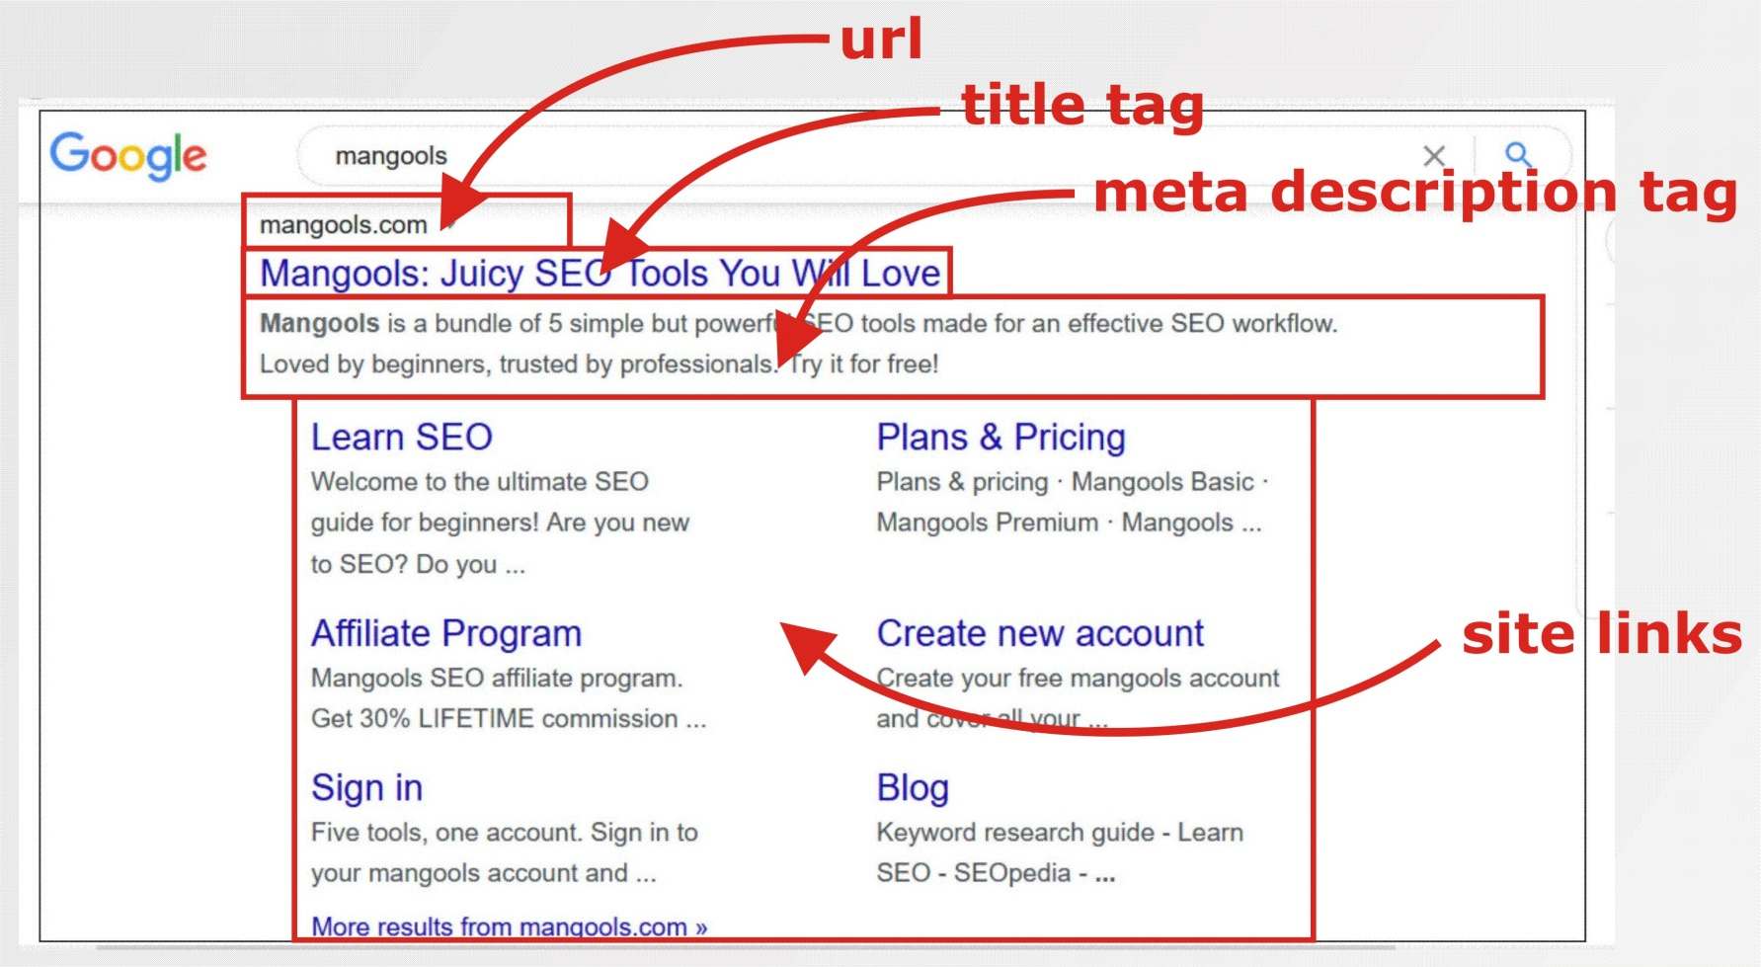
ONLINE MARKETING / 10
Search engine marketing: SEO, SEA en SEP

Slide 26
ONLINE MARKETING / 10
Search engine marketing: SEO, SEA en SEP

Slide 27
ONLINE MARKETING / 10
Search engine marketing: SEO, SEA en SEP

Slide 28
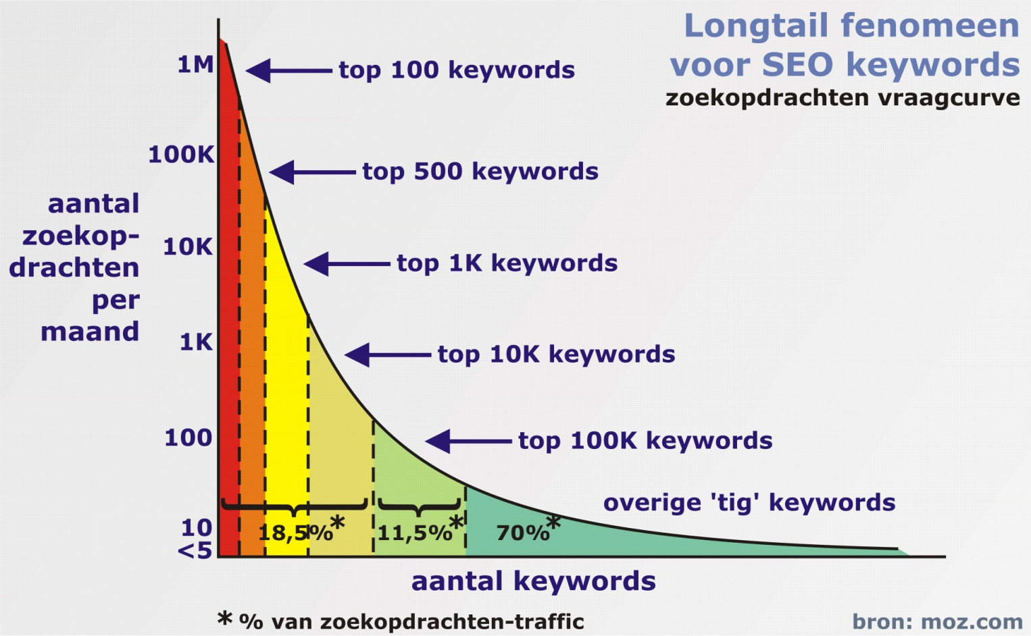
ONLINE MARKETING / 10
Search engine marketing: SEO, SEA en SEP

Slide 29
ONLINE MARKETING / 10
Search engine marketing: SEO, SEA en SEP

Slide 30
ONLINE MARKETING / 10
Search engine marketing: SEO, SEA en SEP

Slide 31
ONLINE MARKETING / 10
Search engine marketing: SEO, SEA en SEP

Slide 32
ONLINE MARKETING / 10
Search engine marketing: SEO, SEA en SEP

Slide 33
ONLINE MARKETING / 10
Search engine marketing: SEO, SEA en SEP

Slide 34
ONLINE MARKETING / 10
Search engine marketing: SEO, SEA en SEP

Slide 35
ONLINE MARKETING / 10
Search engine marketing: SEO, SEA en SEP

Slide 36
ONLINE MARKETING / 10
Search engine marketing: SEO, SEA en SEP

Slide 37
ONLINE MARKETING / 10
Search engine marketing: SEO, SEA en SEP

Slide 38
ONLINE MARKETING / 10
Search engine marketing: SEO, SEA en SEP

Slide 39
ONLINE MARKETING / 10
Search engine marketing: SEO, SEA en SEP

Slide 40
ONLINE MARKETING / 10
Search engine marketing: SEO, SEA en SEP

Slide 41
ONLINE MARKETING / 10
Search engine marketing: SEO, SEA en SEP

Slide 42
ONLINE MARKETING / 10
Search engine marketing: SEO, SEA en SEP

Slide 43
ONLINE MARKETING / 10
Search engine marketing: SEO, SEA en SEP

Slide 44
ONLINE MARKETING / 10
Search engine marketing: SEO, SEA en SEP

Slide 45
ONLINE MARKETING / 10
Search engine marketing: SEO, SEA en SEP

Slide 46
ONLINE MARKETING / 10
Search engine marketing: SEO, SEA en SEP

Slide 47
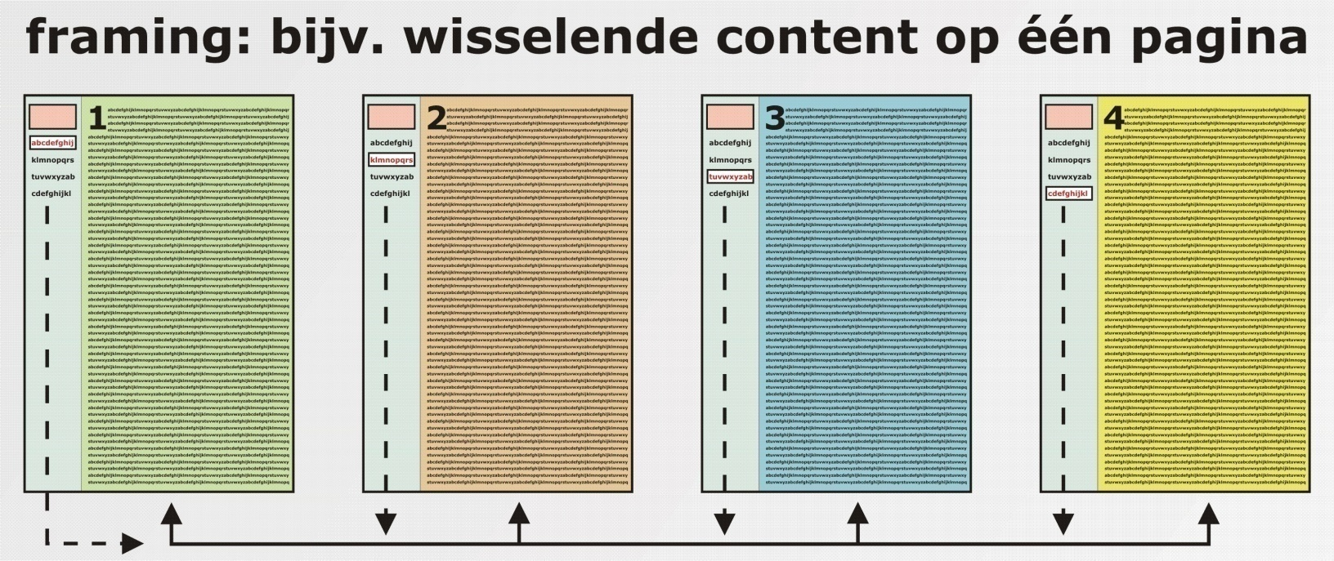
ONLINE MARKETING / 10
Search engine marketing: SEO, SEA en SEP

Slide 48
ONLINE MARKETING / 10
Search engine marketing: SEO, SEA en SEP

Slide 49
ONLINE MARKETING / 10
Search engine marketing: SEO, SEA en SEP

Slide 50
ONLINE MARKETING / 10
Search engine marketing: SEO, SEA en SEP

Slide 51
ONLINE MARKETING / 10
Search engine marketing: SEO, SEA en SEP

Slide 52
ONLINE MARKETING / 10
Search engine marketing: SEO, SEA en SEP

Slide 53
ONLINE MARKETING / 10
Search engine marketing: SEO, SEA en SEP

Slide 54
ONLINE MARKETING / 10
Search engine marketing: SEO, SEA en SEP

Slide 55
ONLINE MARKETING / 10
Search engine marketing: SEO, SEA en SEP

Slide 56
ONLINE MARKETING / 10
Search engine marketing: SEO, SEA en SEP

Slide 57
ONLINE MARKETING / 10
Search engine marketing: SEO, SEA en SEP

Slide 58
ONLINE MARKETING / 10
Search engine marketing: SEO, SEA en SEP

