Slide 1
ONLINE MARKETING / 13

Slide 3
ONLINE MARKETING / 13
Digital advertising, affiliates en performance based

Slide 4
ONLINE MARKETING / 13
Digital advertising, affiliates en performance based

Slide 5
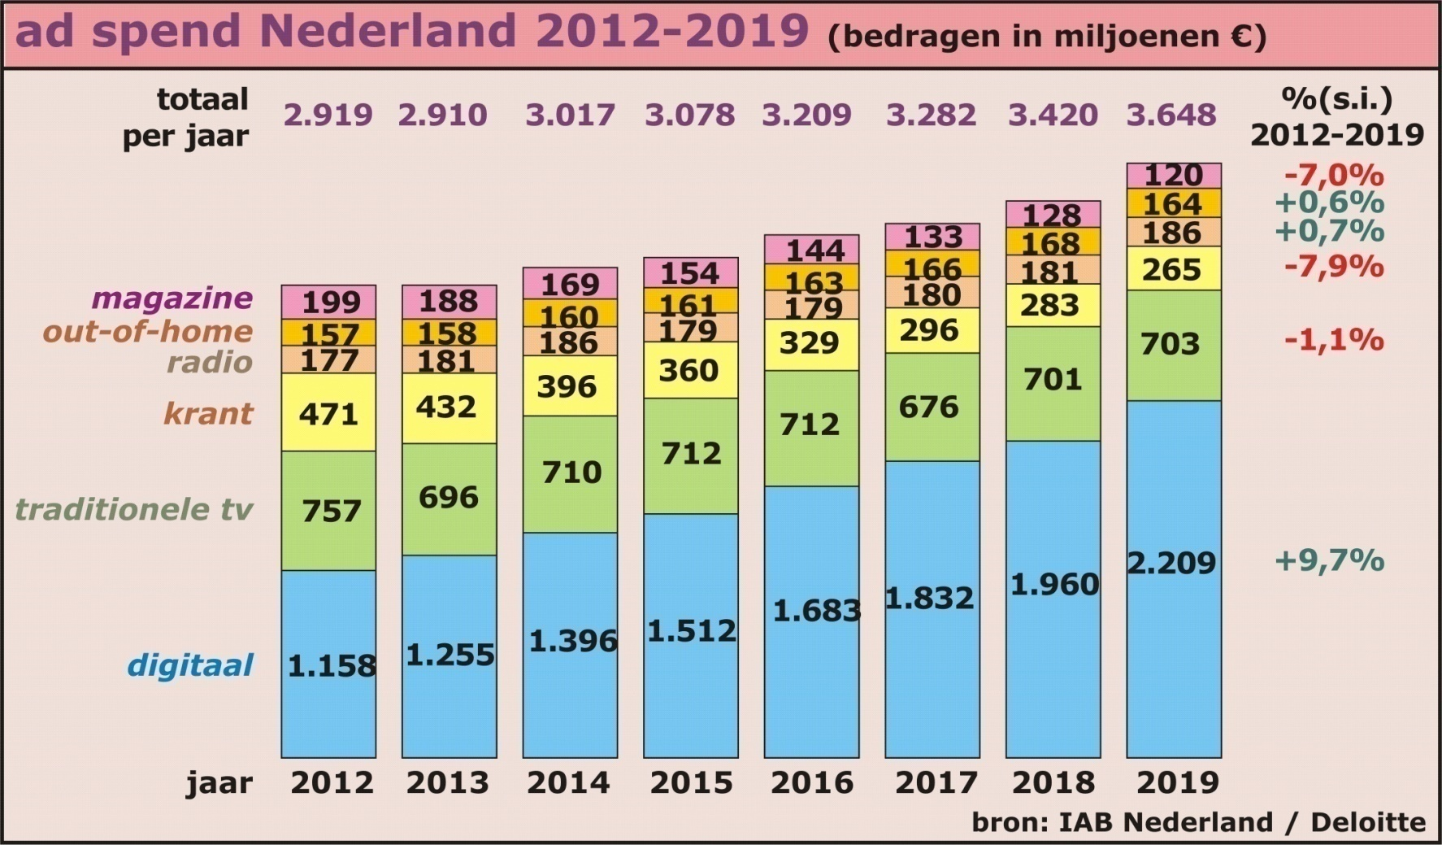
ONLINE MARKETING / 13
Digital advertising, affiliates en performance based

Slide 6
ONLINE MARKETING / 13
Digital advertising, affiliates en performance based

Slide 7
ONLINE MARKETING / 13
Digital advertising, affiliates en performance based

Slide 8
ONLINE MARKETING / 13
Digital advertising, affiliates en performance based

Slide 9
ONLINE MARKETING / 13
Digital advertising, affiliates en performance based

Slide 10
ONLINE MARKETING / 13
Digital advertising, affiliates en performance based

Slide 11
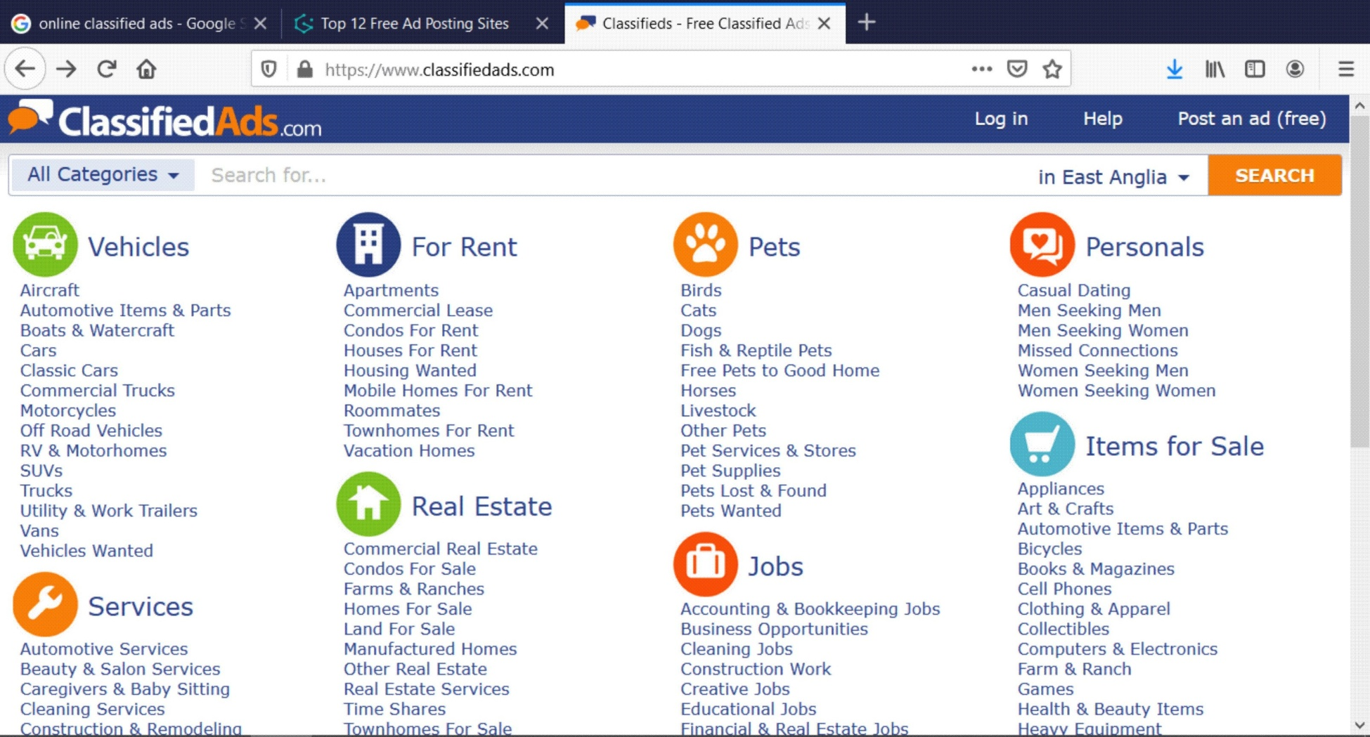
ONLINE MARKETING / 13
Digital advertising, affiliates en performance based

Slide 12
ONLINE MARKETING / 13
Digital advertising, affiliates en performance based

Slide 13
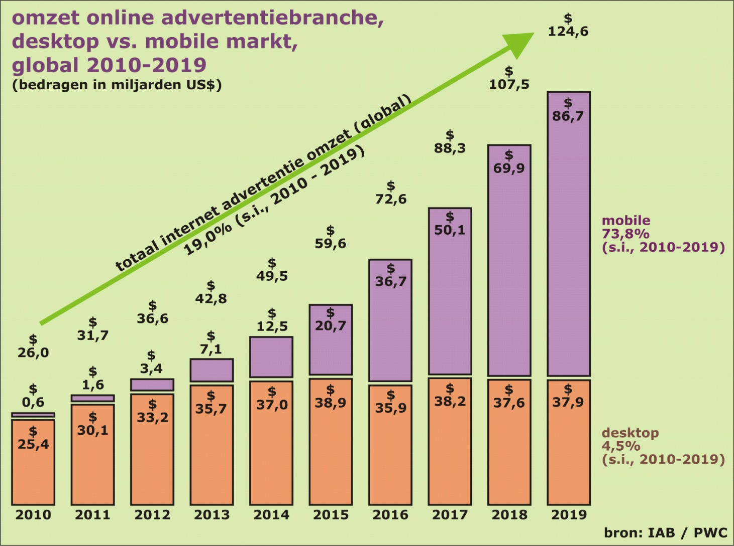
ONLINE MARKETING / 13
Digital advertising, affiliates en performance based

Slide 14
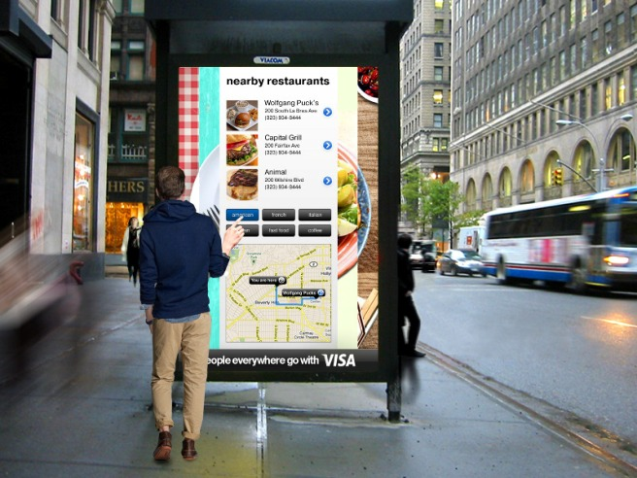
ONLINE MARKETING / 13
Digital advertising, affiliates en performance based

Slide 15
ONLINE MARKETING / 13
Digital advertising, affiliates en performance based

Slide 16
ONLINE MARKETING / 13
Digital advertising, affiliates en performance based

Slide 17
ONLINE MARKETING / 13
Digital advertising, affiliates en performance based

Slide 19
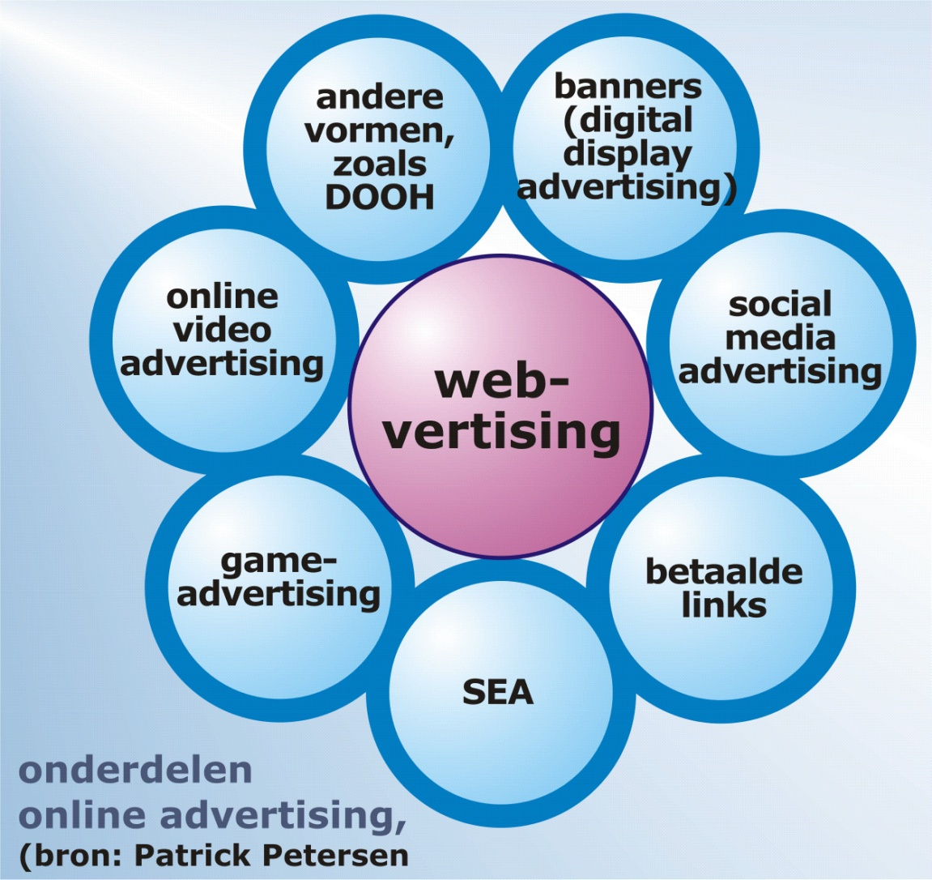
ONLINE MARKETING / 13
Digital advertising, affiliates en performance based

Slide 20
ONLINE MARKETING / 13
Digital advertising, affiliates en performance based

Slide 21
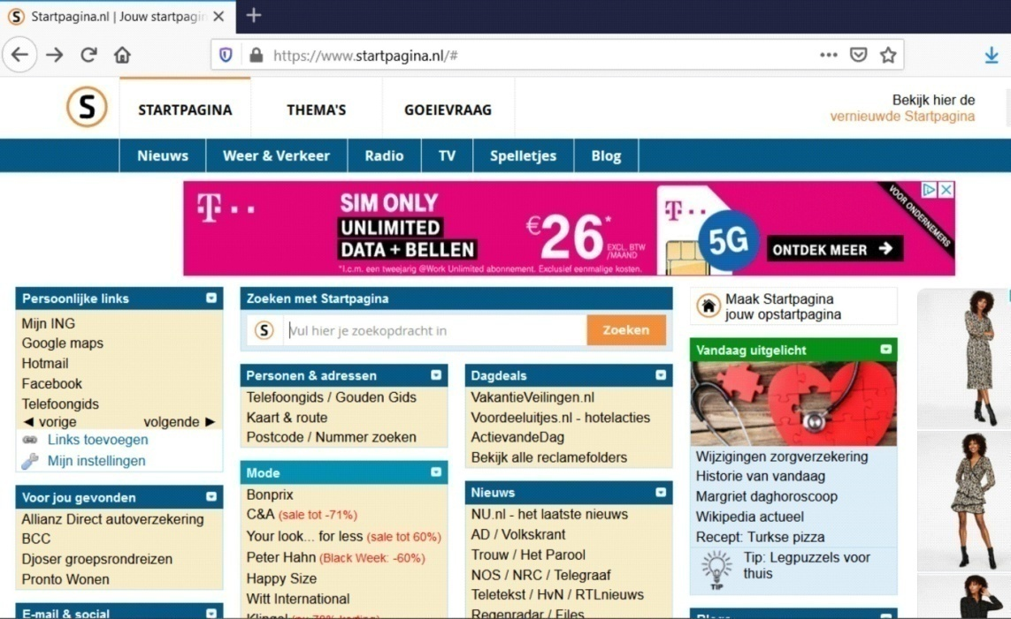
ONLINE MARKETING / 13
Digital advertising, affiliates en performance based

Slide 22
ONLINE MARKETING / 13
Digital advertising, affiliates en performance based

Slide 23
ONLINE MARKETING / 13
Digital advertising, affiliates en performance based

Slide 24
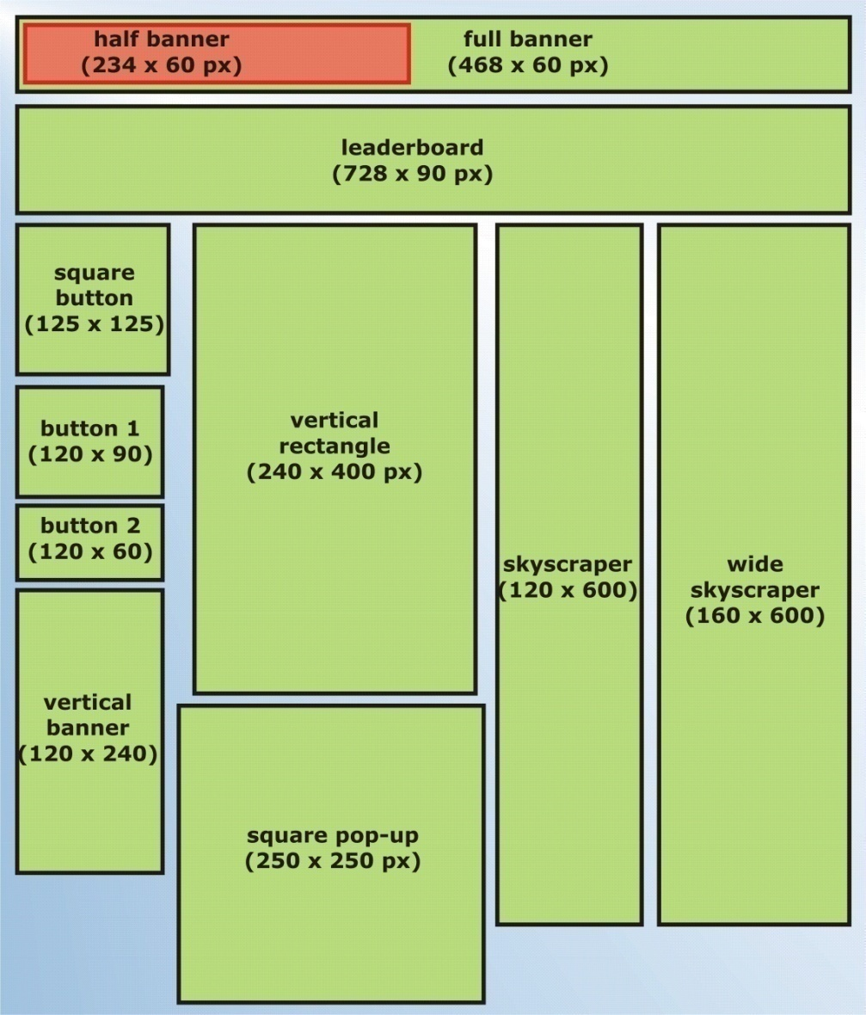
ONLINE MARKETING / 13
Digital advertising, affiliates en performance based

Slide 25
ONLINE MARKETING / 13
Digital advertising, affiliates en performance based

Slide 26
ONLINE MARKETING / 13
Digital advertising, affiliates en performance based

Slide 27
ONLINE MARKETING / 13
Digital advertising, affiliates en performance based

Slide 28
ONLINE MARKETING / 13
Digital advertising, affiliates en performance based

Slide 29
ONLINE MARKETING / 13
Digital advertising, affiliates en performance based

Slide 30
ONLINE MARKETING / 13
Digital advertising, affiliates en performance based

Slide 31
ONLINE MARKETING / 13
Digital advertising, affiliates en performance based

Slide 33
ONLINE MARKETING / 13
Digital advertising, affiliates en performance based

Slide 34
ONLINE MARKETING / 13
Digital advertising, affiliates en performance based

Slide 35
ONLINE MARKETING / 13
Digital advertising, affiliates en performance based

Slide 36
ONLINE MARKETING / 13
Digital advertising, affiliates en performance based

